Slide 1
Best locality for restaurant
Submitted By: Taruna Sahu
M.tech Data Science
School of Data Science and Forecasting
DAVV,Indore

Slide 2
Problem statement
In Indore, if someone is looking to open an Indian restaurant, where would you recommend that they open it?
According to a report, 60% of restaurants shut down within the first year of operations, and up to 80% of restaurants close their operations in the first five years

Slide 3

Why Do Restaurants Fail?
There are many reasons that a restaurant may fail, but here are the 6 most common reasons:
Bad Location
Inexperience
Inflated costs
Improper pricing
Lack of Marketing
Disorganization

Slide 4
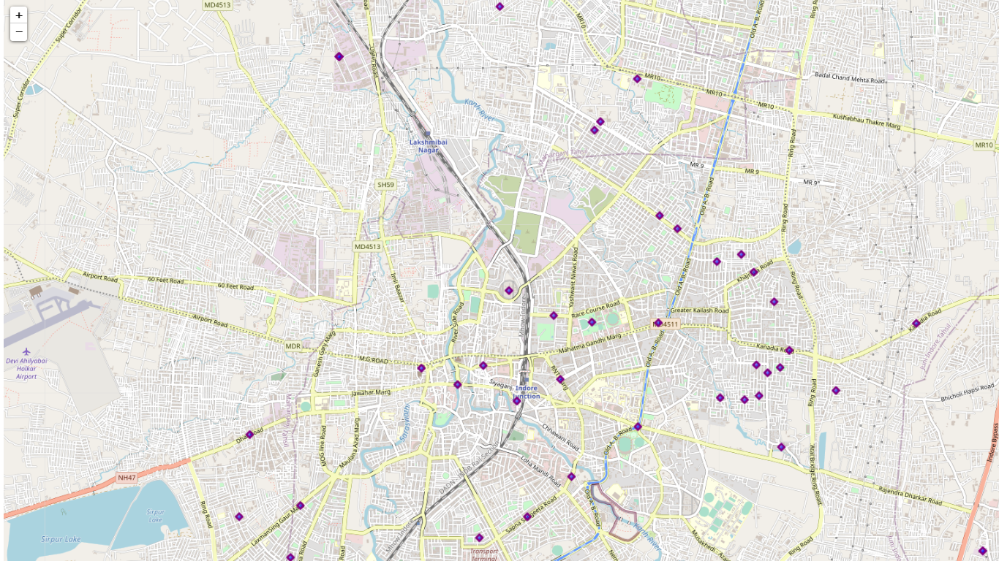
Objective
My project aims to find the best location to open an Indian restaurant in the city of Indore, India, to maximize the profit of the owner.

Slide 5
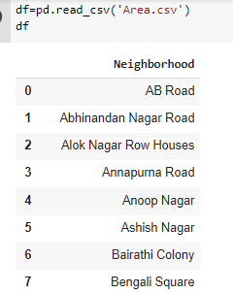
Methodology
Data Collection:
Dataset containing Neighborhoods of Indore, the dataset holds the names Neighborhood in Indore extracted from Wikipedia. Here is a link to the dataset. https://en.wikipedia.org/wiki/Category:Neighbourhoods_in_Indore
There are total 75 localities in Indore

Slide 6
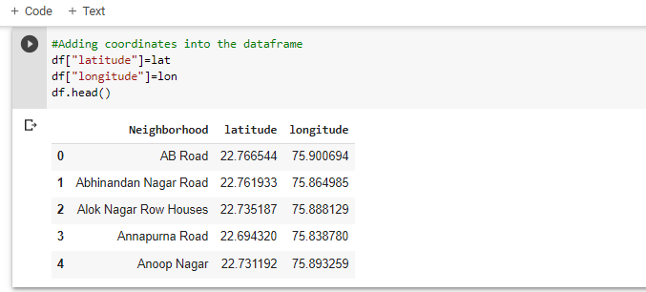
Methodology
Data collection:
I used python library geopy to fiind coordinates of neighborhoods in the data frame. Data required some scraping for geopy to correctly give the coordinates of Neighborhoods of Indore in a data frame

Slide 7
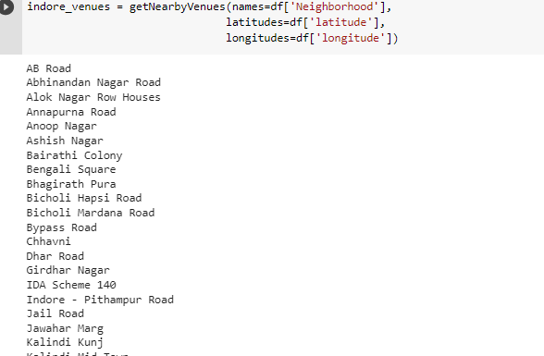
Methodology
I used Foursquare API to explore the most common places of a neighborhood in the form of a JSON file.

Slide 8
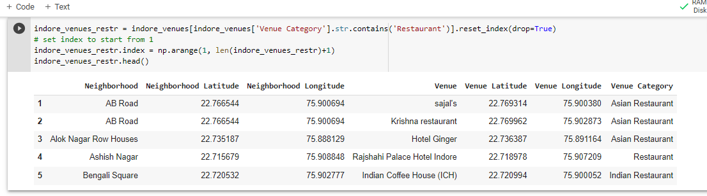
Methodology
Data Preprations:
Getting all the neighborhood longitude and latitude
Getting all the venue
Describing the category of venue

Slide 9
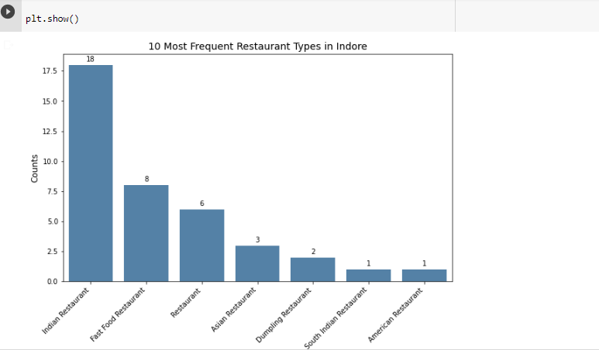
Methodology
Categories of Restaurant in Indore

Slide 10
Analytic Aproach

